Slide 1
Introduction
National Highway Traffic Safety Administration of the USA suggests that the economical and societal harm from car accidents can cost up to $871 billion in a single year.
According to 2017 WSDOT data, a car accident occurs every 4 minutes and a person dies due to a car crash every 20 hours in the state of Washington while Fatal crashes went from 508 in 2016 to 525 in 2017, resulting in the death of 555 people.

Slide 2
Data
The dataset used for this project is based on car accidents which have taken place within the city of Seattle, Washington from the year 2004 to 2020. This data is regarding the severity of each car accidents along with the time and conditions under which each accident occurred.

Slide 3
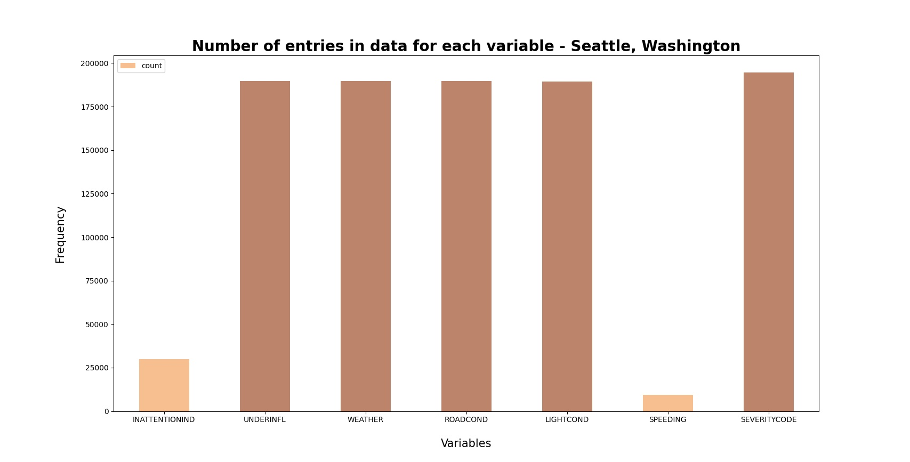

Slide 4
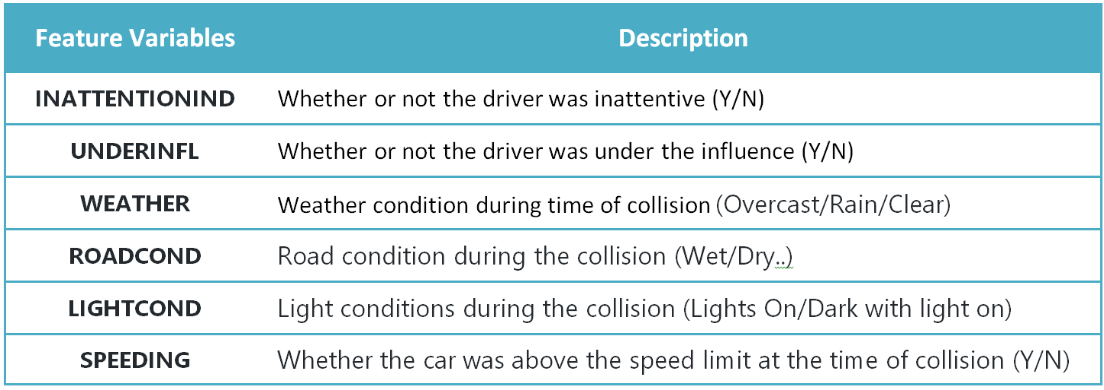
Feature Selection

Slide 5
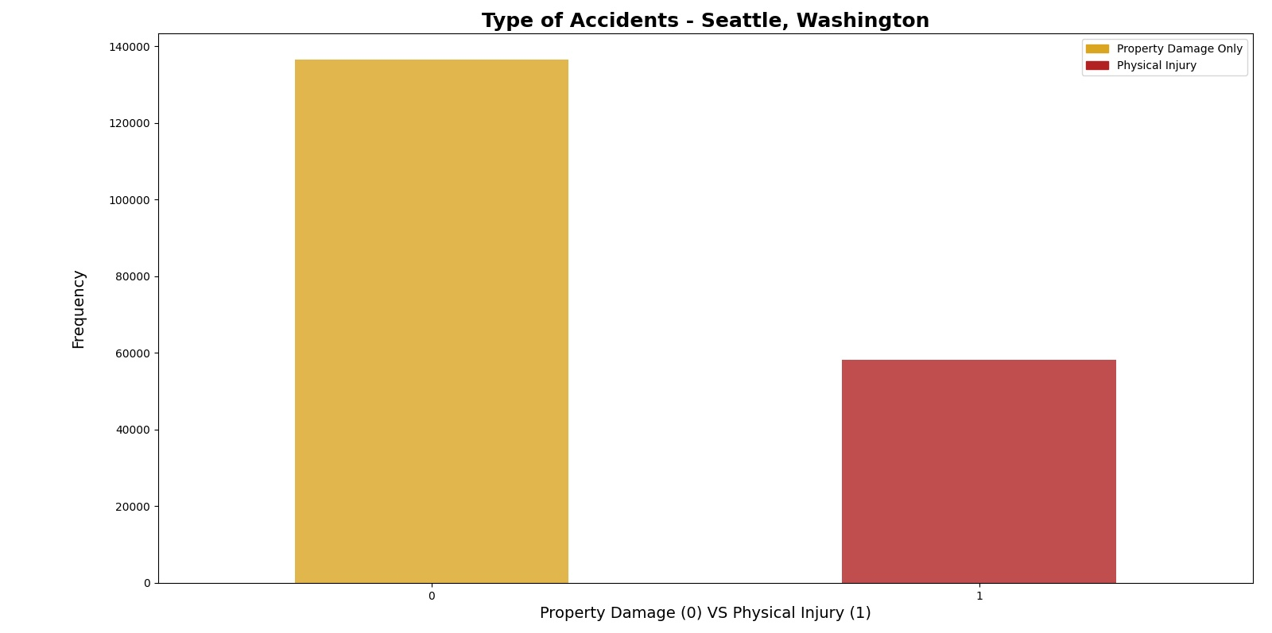
Methodology

Slide 6
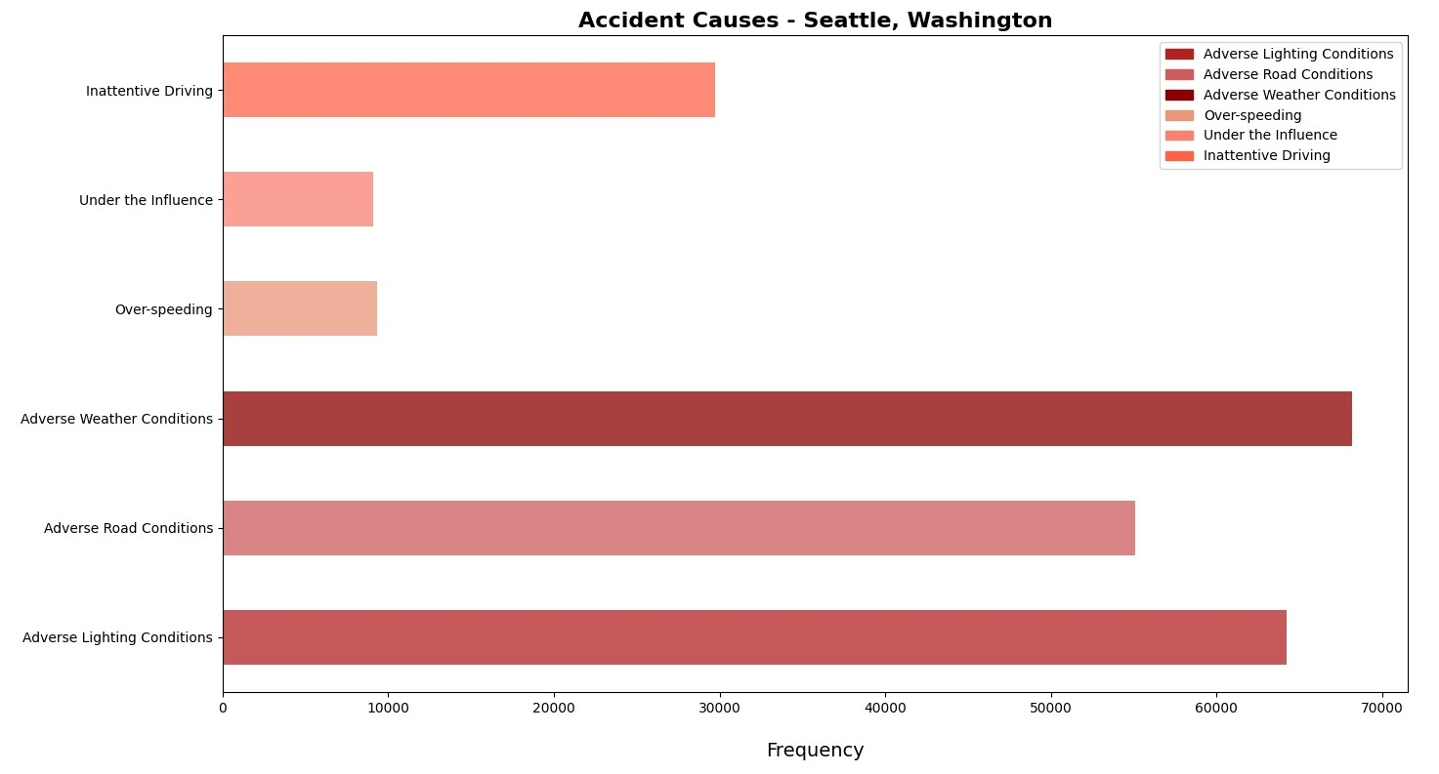

Slide 7
Machine Learning Models
Logistic Regression: Logistic regression is a statistical model that in its basic form uses a logistic function to model a binary dependent variable
Decision Tree Analysis: The Decision Tree Analysis breaks down a data set into smaller subsets while at the same time an associated decision tree is incrementally developed. The final result is a tree with decision nodes and leaf nodes.
k-Nearest Neighbor: K nearest neighbors is a simple algorithm that stores all available cases and classifies new cases based on a similarity measure (based on distance)

Slide 8
Results
Decision Tree
The criterion chosen for the classifier was entropy and the max depth was 6.

Slide 9
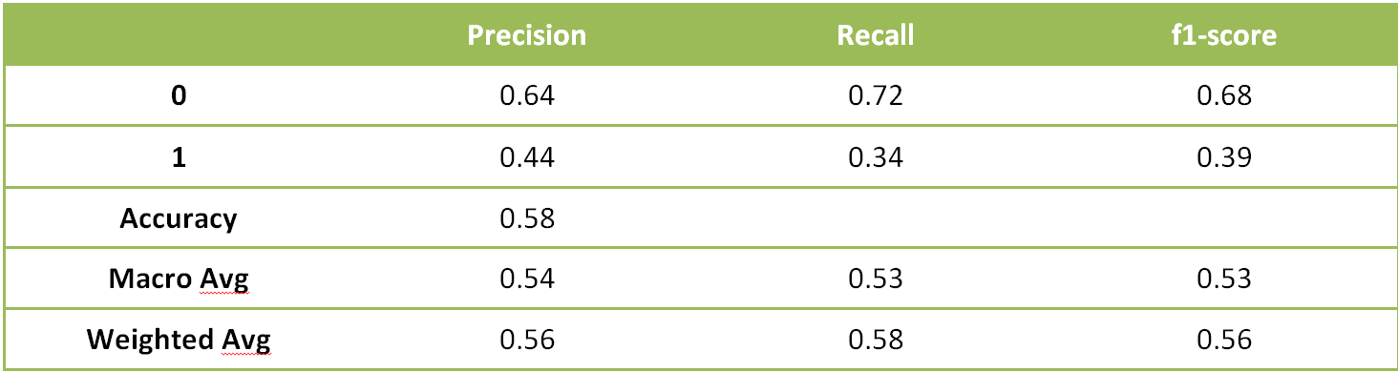
Decision Tree Classification Report

Slide 10
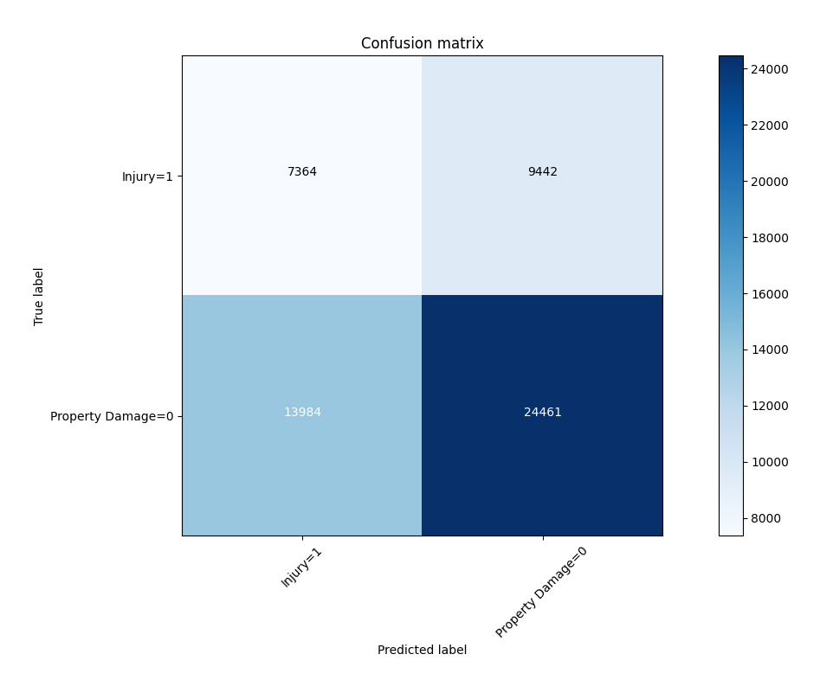
Decision Tree Confusion Matrix

Slide 11
Logistic Regression
The C used for regularization strength was 0.01 whereas the solver used was liblinear.

Slide 12
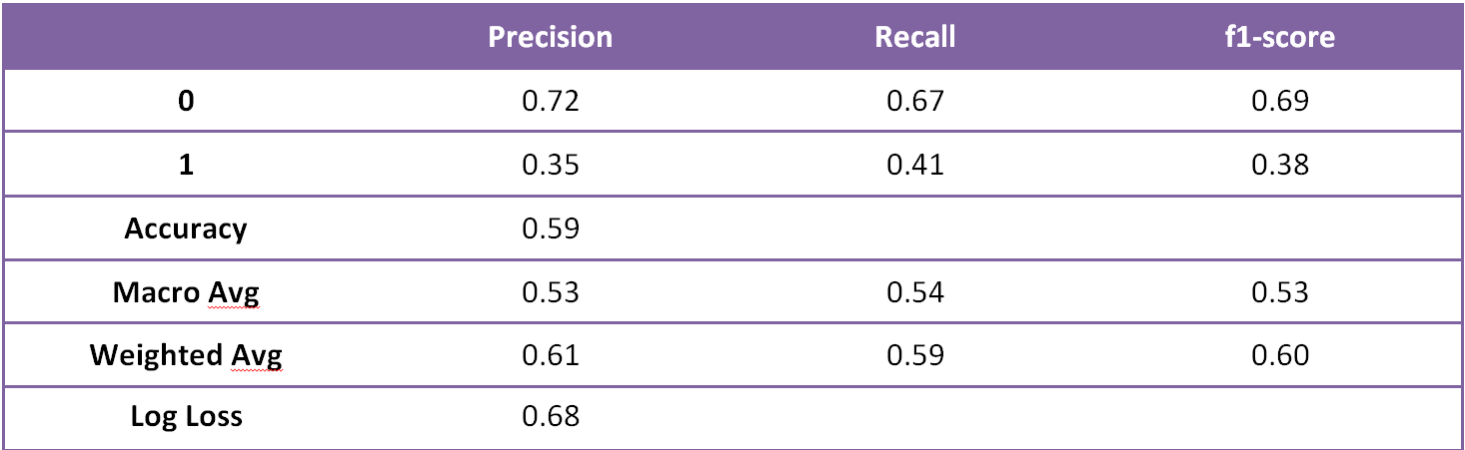
Logistic Regression Classification Report

Slide 13
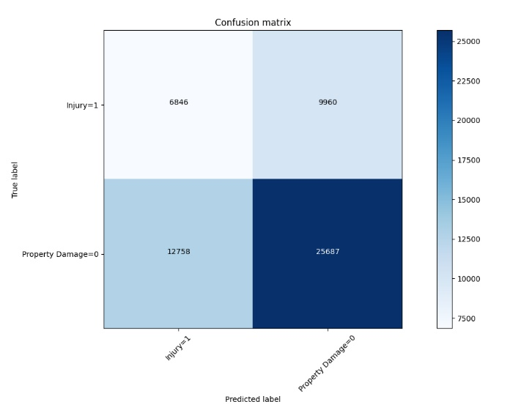
Logistic Regression Confusion Matrix

Slide 14
k-Nearest Neighbor
The best K, as shown below, for the model where the highest elbow bend exists is at 4.

Slide 15
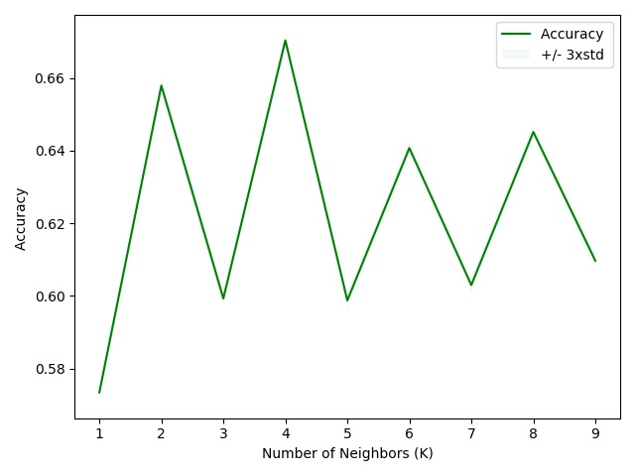
Choosing the best K

Slide 16
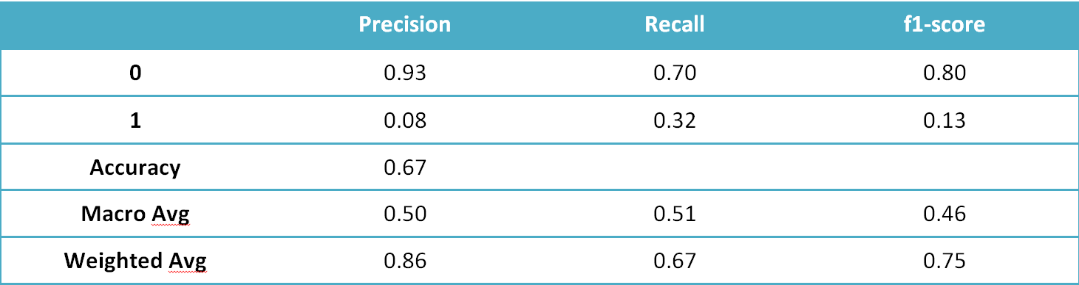
k-Nearest Neighbor Classification Report

Slide 17
Model Accuracy
Precision: Precision refers to the percentage of results which are relevant, in simpler terms it can be seen as how many of the selected items from the model are relevant. Mathematically, it is calculated by dividing true positives by true positive and false positive
Recall: Recall refers to the percentage of total relevant results correctly classified by the algorithm. In simpler terms, it tells how many relevant items were selected. It is calculated by dividing true positives by true positive and false negative
F1-Score: f1-score is a measure of accuracy of the model, which is the harmonic mean of the model’s precision and recall. Perfect precision and recall is shown by the f1-score as 1, which is the highest value for the f1-score, whereas the lowest possible value is 0 which means that either precision or recall is 0

Slide 18
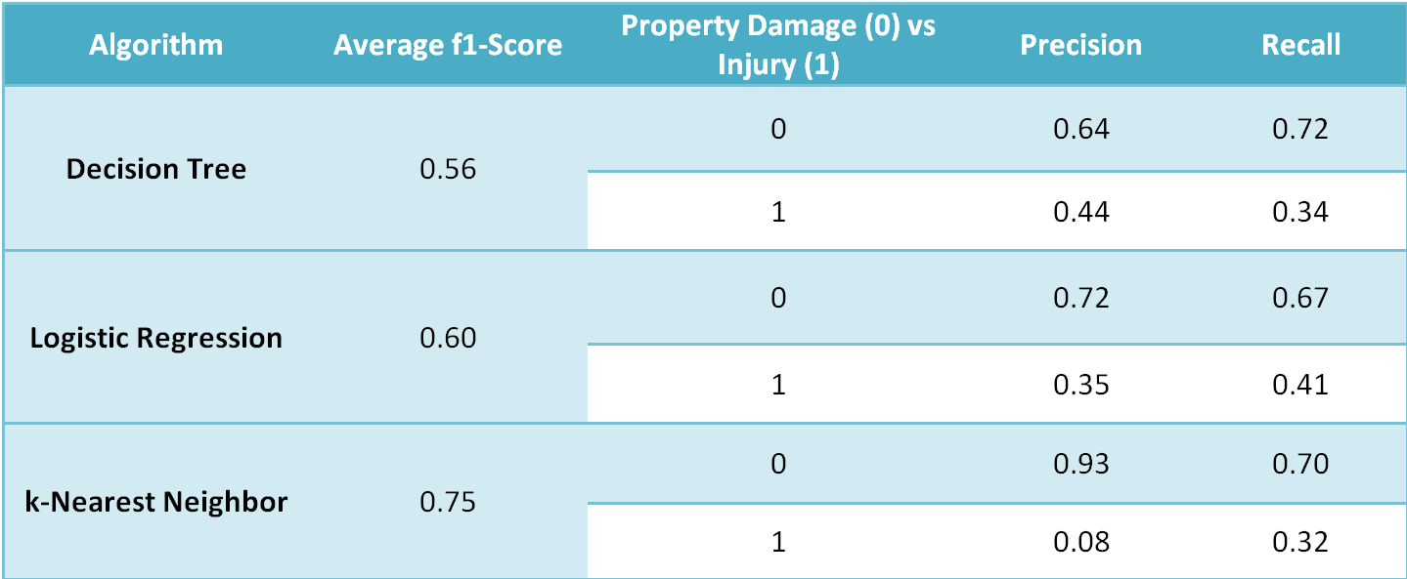

Slide 19
Conclusion
f1-score is highest for k-Nearest Neighbor at 0.75
k-Nearest Neighbor model performs poorly in the precision of 1 at 0.08.
Decision Tree has a more balanced precision for 0 and 1.
Logistic Regression is more balanced when it comes to recall of 0 and 1.
f1-score of the two models are very close but for the Logistic Regression it is higher by 0.04.
It can be concluded that the both the models can be used side by side for the best performance.

Slide 20
Recommendations
The developmental body for Seattle city can assess how much of these accidents have occurred in a place where road or light conditions were not ideal for that specific area and could launch development projects for those areas where most severe accidents take place in order to minimize the effects of these two factors.
Car drivers could also use this data to assess when to take extra precautions on the road under the given circumstances of light condition, road condition and weather, in order to avoid a severe accident, if any.

